Slide 1
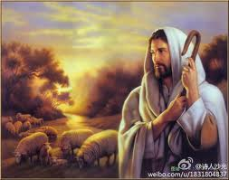
活出爱
Live Out Love
泥土音乐 Clay Music

Slide 2
有一份爱 从天而来 比山高 比海深 测不透 摸不着 却看的见 因为有你 因为有我 甘心给 用心爱 把心中这一份爱 活出来
There is love from heaven It is higher than the mountains and deeper than the ocean
You can’t measure it, you can’t touch it, but you can see it Because you and I are willing to give, to love, to live out the love in our hearts

Slide 3
耶稣的爱激励我 敞开我的生命 让自己成为家人祝福 耶稣的爱点燃我心中熊熊爱火 我们一起向世界 活出爱
Jesus' love inspires me I want to open my life Let me to be a blessing to others The love of Jesus ignites the fire of love in my heart
Together we live out the love to the world

